Slide 1
CS 4530
Fundamentals of Software Engineering
Module 15: Ethics in Software Engineering
Adeel Bhutta, Rob Simmons and Mitch Wand
Khoury College of Computer Sciences
© 2026 Released under the CC BY-SA license

Slide 2
Goal: to make software an engineering discipline
Software engineering concerns the
design
construction,
and maintenance
Programs are not morally neutral things
programs can have good and ill effects for people
programs represent and encode human values
Software Engineers have professional obligations around ethics
of large programs
over time.
Notes:
Let’s go back to a slide from the first lecture.
Software engineering is about the design, construction, and maintenance of large programs over time.
A goal of this lecture is to convey that this is an activity that requires consideration of ethics because programs are not morally neutral entities, and programming — coding — is almost never a morally neutral action, even if we’re not particularly inclined or trained to think about it in that way.
We’ll mostly cover this by presenting a couple of examples, and finish with a little bit about what our professional organization has to say about ethics

Slide 3
Programs can have good and ill effects

Slide 4
Badly-engineered software can kill people
Therac-25 (1985-1987)
Bug in software caused 100x greater exposure to radiation than intended
At least 6 died
Likely far more suffered: deaths occurred over a period of 2 years!
Weak accountability in manufacturer’s organization
“Therac-25” by Catalina Márquez, Wikimedia commons, CC BY-SA 4.0
https://ethicsunwrapped.utexas.edu/case-study/therac-25
Notes:
Short/new version:
It’s somewhat easier to talk ethics in software engineering in situations where outcomes are obviously bad, like when the Therac-25 radiation therapy machine caused multiple deaths because of a straightforward bug.
Discussion Question:
- What do we know about software engineering that could be applied, broadly, to make sure that this kind of software failure would be less likely?
(Lots of possible answers here: Test driven development! Integration testing and developing a specific testing plan ahead of time! Maybe we need to be a little bit less ”Agile” and a little bit more “Waterfall” in our specs! The Toyota approach to Agile that everyone can shut down the assembly line! I hope someone mentions blameless postmortems, because that’s 1) somewhat correct and 2) blameless postmortems are harder to do when there are likely to be life-altering legal consequences.)
Long/older version:
A bug in the software controlling the THERAC-25 radiation treatment machine resulted in the death of at least 6 patients, and administered countless additional overdoses. Investigations after-the-fact found that the manufacturer had extremely poor software development and quality assurance processes, without independent code review, without testing, and without safety checks. The machine operators were assured that overdoses were impossible - software was reused from older machines which had hardware interlocks to prevent these software defects from being catastrophic. Note that one result of this incident is stronger standards for safety-critical (in particular: medical) software, which now require rigorous quality assurance practices. The manufacturer of the machine, however, could have easily prevented further damage had they immediately detected and resolved the bug after the first reported incident in 1985.
Discussion Questions:
1. Who should be responsible for the errors in a medical device?
2. What moral responsibility do creators of software have for the adverse consequences that flow from flaws in that software?

Slide 5
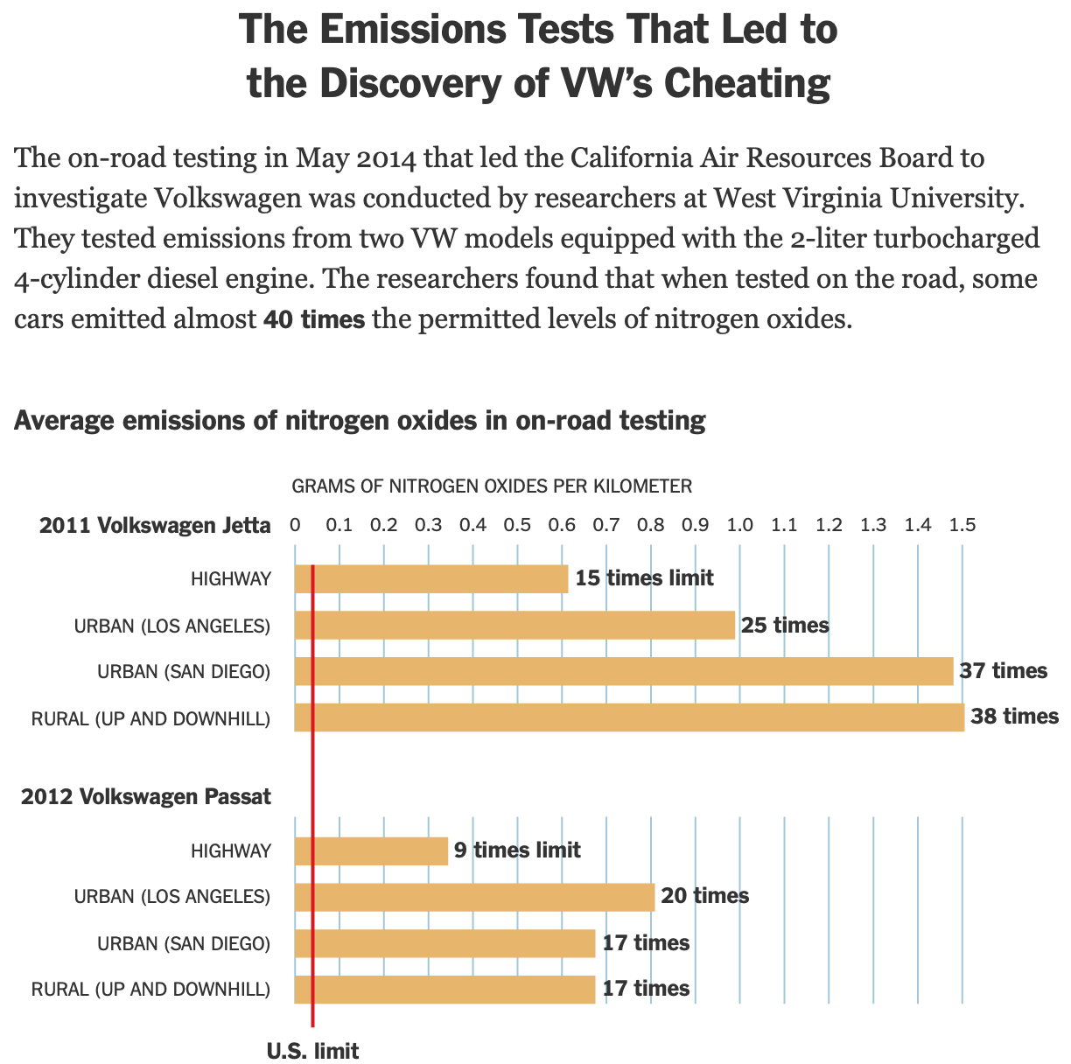
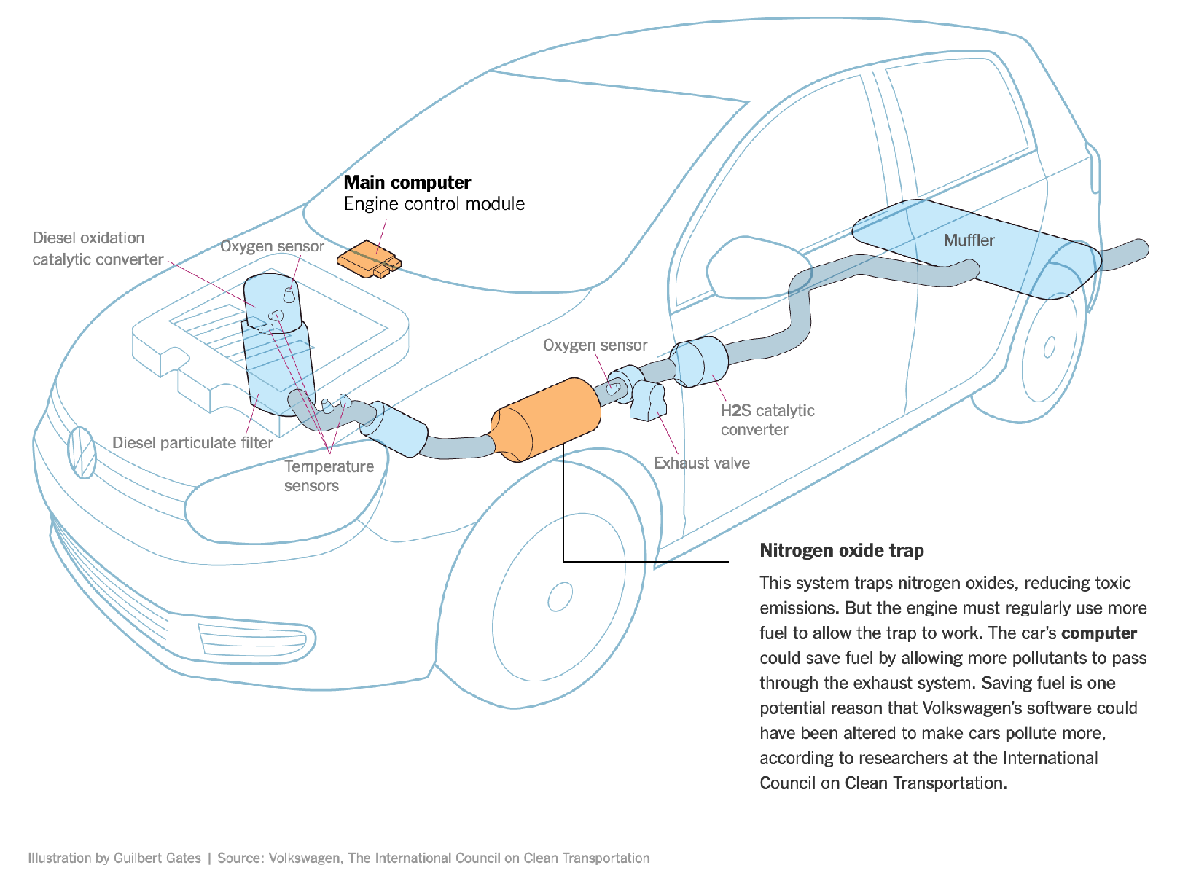
Software can enable criming executives
Example: Volkswagen diesel emissions
$14.7 billion settlement
Jail time for Volkswagen Execs
“How Volkswagen’s ‘Defeat Devices’ Worked” By Guilbert Gates, Jack Ewing, Karl Russell and Derek Watkins
“Volkswagen executives get prison time in 'Dieselgate' scandal” By Kevin Williams, May 2025
Notes:
It’s somewhat easier to talk ethics in software engineering in situations where motivations are obviously bad, like when software was written for the specific purpose of cheating on emissions standards.
Volkswagen’s engine control unit had customized software to detect when the car was under an emissions test and tune the engine to reduce performance and emissions, resulting in emissions tests that significantly under-represented the actual emissions of the vehicle. (Click) This software mislead regulators and consumers, and ultimately Volkswagen agreed to spend $14.7 billion in a settlement, and was subject to significant public relations damage.
We don’t have to agree about the wisdom of emissions standards work to agree that this is a textbook failure of professional ethics to write software to bypass regulation. This case involved Volkswagon executives who wrote specific requirements for the software to cheat on emissions, and software engineers that implemented that software understanding its purpose.
Someone went to prison for this. Do you think it was the software engineers, or the business executives? To ask the moral question, who do you think ought to have faced legal consequences for their actions?
(click)
Turns out it was the business executives in this case. That probably means there are some software engineers out there that could have kept their bosses out of prison if they’d refused to implement software that cheated on regulation. Maybe they would have lost their jobs over that refusal. I wonder how they feel about those choices!

Slide 6
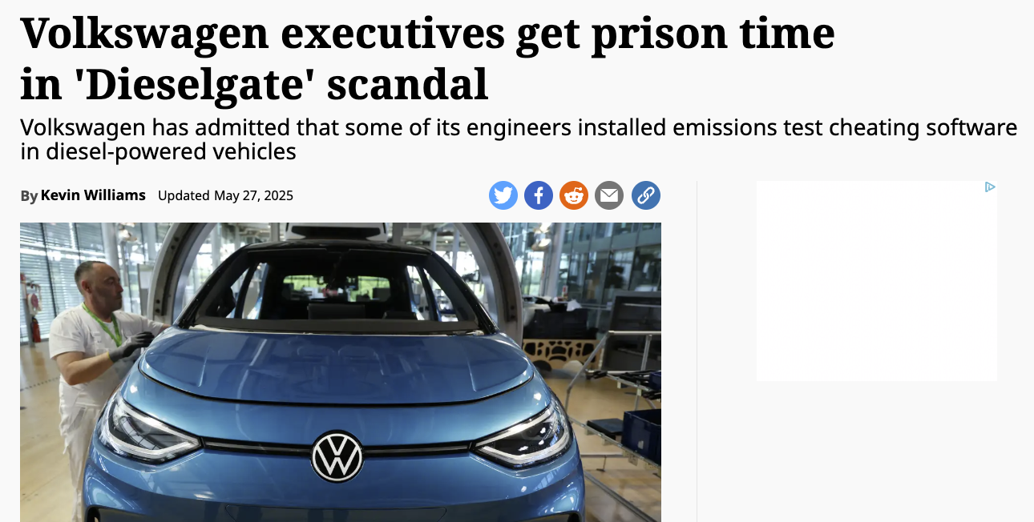
Criming Corporate Bosses Need Software Engineers

Slide 7
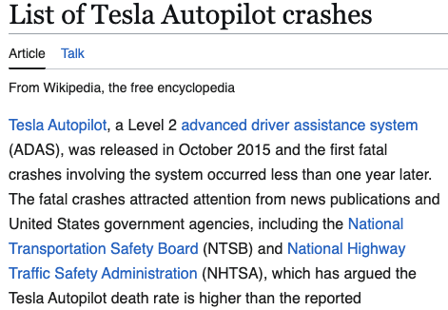
Is This A Good Idea? It Can Depend on What Question You’re Asking
There are deaths here attributed to software bugs!
Tesla will tell you that more lives were saved than if the software hadn’t existed
Notes:
Sticking with cars: there are deaths attributed to the software that pilots Tesla vehicles. But, and let’s take them for their word for the purpose
Rather than asking “is this good” or “is this bad,” let’s ask a limited question:
What are the ethical values that would lead someone to say that Autopilot should be banned or limited?
Possibilities: concern about harm being caused by corporations that can’t or won’t be held responsible, concern about handing life-or-death decisions over software that can’t be inspected or interrogated, desire for individual responsibility over actions and a dislike of putting intermediaries between people and their actions
What are the ethical values that would lead someone to say that Autopilot should be encouraged despite acknowledged limitations?
Possibilities: straightforward utilitarianism is the obvious move here — if you mostly care about minimizing the number of car deaths and you don’t care about corporations or people being held responsible for individual deaths as much
Concluding point: Not everyone will agree on whether a piece of software ought to exist, and those disagreements are often based on people applying different value systems and different ethical frameworks. Realistically, often this results in people talking past each other and/or decisions just getting made based on who has the most power in the situation. It can be valuable in a software engineering process to document why a decision is being made in a way that participants agree with, even if people don’t agree with the the values being applied and the choice being made. This is a kind of documentation that requires talking about what people’s values are.

Slide 8

Is This A Good Idea? What’s “Good” Can Be Different For Different People or Groups
One mark of an exceptional engineer is the ability to understand how products can advantage and disadvantage different groups of human beings
Engineers are expected to have technical aptitude, but they should also have the discernment to know when to build something and when not to
Demma Rodriguez Head of Equity Engineering
Google
Quote: “Software Engineering at Google: Lessons Learned from Programming Over Time,” Wright et al, 2020 (O’Reilly)
Notes:
Being an exceptional engineer means not only that you know HOW to build some great features, but that you have the judgement to be able to identify and reject features or products that drive adverse outcomes.

Slide 9
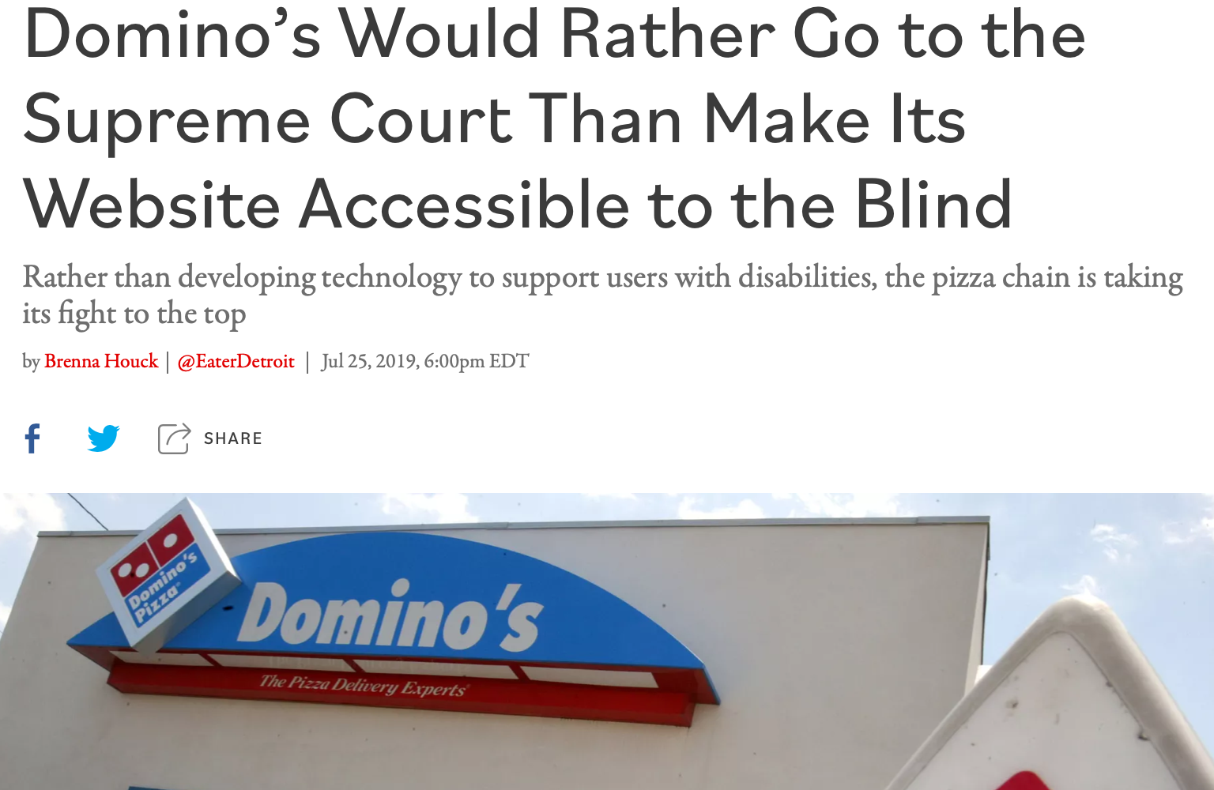
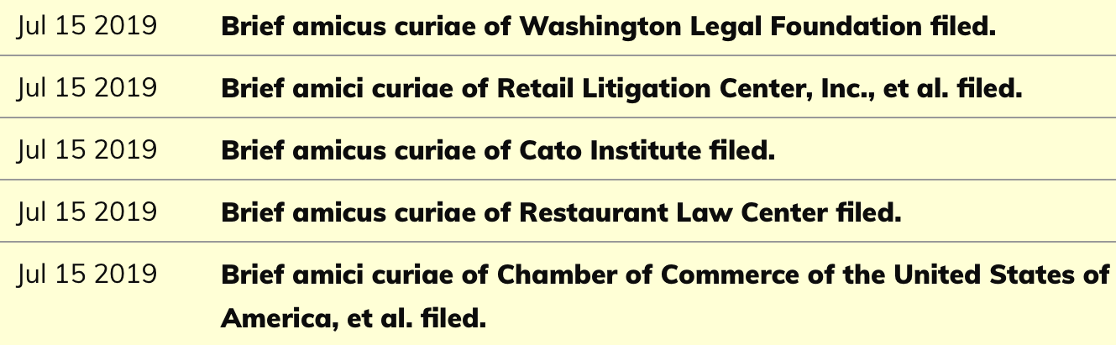
Is This A Good Idea? What’s “Good” Can Be Different For Different People or Groups
Inclusivity and Accessibility: Domino’s Pizza LLC v. Robles
“Domino’s Would Rather Go to the Supreme Court Than Make Its Website Accessible to the Blind” by Brenna Houck, Eater Detroit
Notes:
There are also very direct ways that we can inadvertently construct software that is not inclusive of all of our users. For instance: is our software accessible to users who have disabilities, such as being blind or low-vision? The Americans with Disabilities Act requires that public places must be accessible to people with disabilities. In 2019 a blind man sued Domino’s for not providing an interface for ordering pizza that was compatible with screen-readers, which is a kind of technology that is key to making computer accessible to the blind.
Dominos argued that the ADA only applies to physical interactions, since it was written before Internet, so how are we supposed to know what an accessible website is? The question brought before the supreme court, was, basically: do online retailers need to provide an accessible website? Many within the retail and restaurant industries filed amicus briefs backing Domino’s, stressing the “impossibility of guessing what accessibility means in the online environment.” The supreme court found that the ADA applies to websites, too
http://jlsp.law.columbia.edu/2020/02/13/inaccessible-pizza-delivery-and-the-future-of-the-ada/

Slide 10
Is This A Good Idea? What’s “Good” Can Be Different For Different People or Groups
“Earlier this week, X announced it will soon roll out a new function, allowing blocked accounts to still view public posts by users who have blocked them… One commenter wrote, “Big day for stalkers and harassers,” while another stated, “That’s not blocking. It’s supporting stalking.””
https://tech.yahoo.com/apps/articles/bluesky-app-trends-elon-musk-172408742.html
Notes:
Discussion 1: A common way in which software can create severely different outcomes for different groups is stalking and intimate partner violence. Many people aren’t affected by stalking, but for people who are, lots of modern web technology provides suprising threats or negative outcomes. How could something as simple as GameNite’s “X entered chat” feature be used by a stalker? (Could let someone see when someone is home, measure routines, etc.) How could something like that be mitigated? (Create a “silent mode” where you don’t register as having shown up in chat.)
Discussion 2: What features are you implementing in your projects that might be useful to a stalker or an abusive partner? If you were doing this for real, would it make sense to try to mitigate this risk, or just build something else?

Slide 11
Programs represent and encode human values

Slide 12
ML (also LLMs, etc.) Reinforce, “Launder” Bias
The COMPAS sentencing tool discriminates against black defendants
 | ALL | WHITE DEFENDANTS | BLACK DEFENDANTS
Labeled High Risk, But Didn’t Re-Offend | 32% | 23% | 44%
Labeled Low Risk, Yet Did Re-Offend | 37% | 47% | 28%
Analysis of Broward County data: “How We Analyzed the COMPAS Recidivism Algorithm” by Larson et al.
Notes:
Some states use software to assess a criminal defendant’s likelihood of recidivism - a term used to describe criminals who are likely to re-offend. This prediction is used in pre-trial bail hearings, and also in sentencing, where the goal is to assign longer sentences to those most likely to commit another crime. It is likely not unreasonable to be concerned that some judges might be biased against certain defendants, and assign harsher sentences based on those biases. If computers can accurately predict which defendants are likely to commit new crimes, we could potentially reduce bias in our criminal justice system.
Here are the results of an evaluation of one model, the COMPAS Sentencing Tool in Broward County, Florida.
The percentage of false positives and false negatives was roughly 30% in both ways (not great, in any case!)
But if you break down this data by race, you see that black defendants are far more likely to be falsely labeled as high risk than are white defendants. (And vice versa: white defendants are far more likely to be falsely labeled as low risk)
When building such tools, it’s vital to evaluate them on multiple dimensions to ensure that we are not simply re-enforcing existing biases.

Slide 13
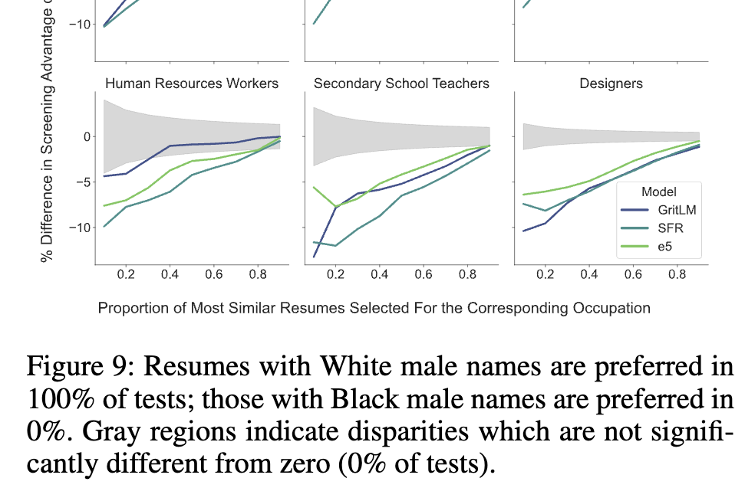
ML (also LLMs, etc.) Reinforce, “Launder” Bias
Systems are trained on who got hired in the past
Human biases led to people with names identified as “white” getting hired more
Good news: Machine learning algorithms can be help in teasing out how we’re actually making decisions (sometimes badly!)
Kyra Wilson & Aylin Caliskan, “Gender, Race, and Intersectional Bias in Resume Screening via Language Model Retrieval”
https://ojs.aaai.org/index.php/AIES/article/view/31748
Notes:
Machine learning algorithms — which is what most people called “AI” before we started calling large language models “AI” — does have a particular tendency to get trained on human decision making that is biased, and learn to match that biased human decision making.
This can be valuable when we use ML to understand the human biases encoded in data — if we train a model based on the decision making by humans and observe that it is applying heavy weights to race, that can be a signal that there’s racial bias in the human decision making.
But if we’re trying to use a machine learning algorithm to influence decisions that affect people, and we don’t want there to be biased outcomes, this is a very difficult effect to get rid of. Even if we don’t give the algorithm data (like race) that we don’t want it making decisions based on, the algorithm can determine find proxies (like names) that predict the patterns seen in the training data, and therefore drive the decisions that the algorithm makes when it’s deployed.

Slide 14
Another example: Stable Matching and the NRMP
“When residencies were first introduced, around 1900, hospitals began competing with one another to secure the best residents as early as possible. By the 1940s, positions were being offered in the third-year of medical school. Students were making career decisions without adequate exposure to their options, and hospitals were making hiring decisions with little data.”
https://pmc.ncbi.nlm.nih.gov/articles/PMC3399603/
Notes:
This point — that data-driven algorithms can reflect the biases of their data — is probably not a new one.
This next example is a more fundamental example of how a program can enforce values and reflect biases without ”big data” being anywhere in the neighborhood.
(click)
Last week was Match Week, when almost every final-year medical student in the United States is paired with a residency program for the next stage of their education.
The Match was created to solve a policy problem: hospitals wanted the best students and kept making earlier and earlier offers to students to try to lock in the best students. Who applied to a college early admission? Does anyone think you would be better served by an early admission program where you applied in the fall of your junior year of high school? That was basically what was happening in the 1940s.

Slide 15
Stable Matching and the NRMP
1952 National Resident Matching Program — big centralized assignment of residents to programs.
Stable Matching is a property of weighted graphs: if Jimmy gets assigned to Mass General but would prefer Emory University, Emory prefers everyone assigned to them over Jimmy. (No defections.)
Algorithm naturally has “proposers” and “acceptors,” and generalizing how applications generally work, natural to make potential applicants the proposers.
Multiple stable matchings usually exist. That “natural” choice leads to the best outcomes for hospitals, and the worst outcomes for students.
Notes:
The Match was created based on the advocacy of students and doctors who realized the status quo was not serving students or the medical profession well. It got rid of early admission entirely — everything happens in a coordinated and centralized fashion, everyone’s preferences — students and med schools — are fed into a centralized algorithm.
It’s a graph algorithm, if this was an algorithms class it wouldn’t take a full lecture to describe how it works. But the property is that it produces a stable match, which is a bipartite graph with the property that there’s no pair of a residency program and a student that would prefer each other over their assigned Match.
First observation: the decision to use an algorithm instead of human decision makers is not a morally neutral one! (Just as the decision to use a driving algorithm rather than a human driver isn’t?) Are there values that might lead someone to oppose using this algorithm?
But also, the algorithm itself is meaningfully biased in ways that its creators did not intend. (Click.) Without going into the details of the algorithm itself, it has two roles, “proposers and acceptors”, and it makes sense intuitively to have med students be the “proposers”, since that’s how application processes generally work.
(Click.)
Unfortunately, this choice causes the algorithm — which remember, was created based on successful student advocacy! — to pick a stable matching that was the worst one for students and the best one for residency programs! We didn’t know this until decades later when computer scientists did the analysis. Without any biased data at all, the algorithm had a bias towards one party in the match!

Slide 16
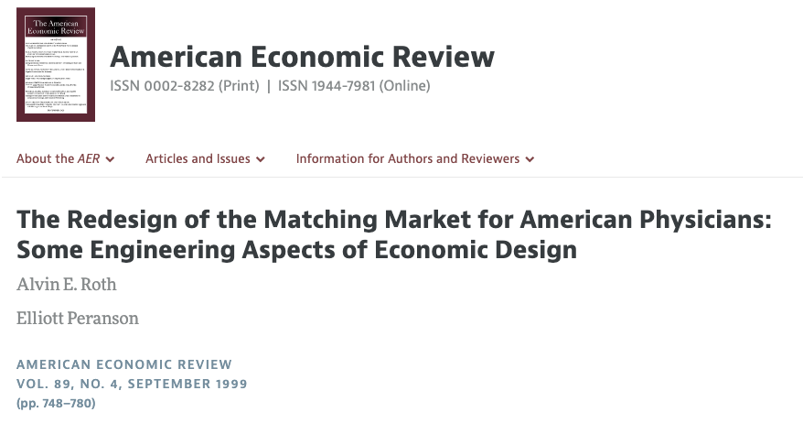
Stable Matching and the NRMP
Fixes several problems
Switches proposer/acceptor roles
Handles the reality of married couples that want to match in the same program or city
https://www.aeaweb.org/articles?id=10.1257/aer.89.4.748
Notes:
Alvin Roth worked on a redesign of the Match algorithm for the National Residency Matching Program. It solved the initial undetected problem of bias by switching the algorithm to favor students’ preferences.
It also addressed another subtle bias with the idea of an algorithm that matches individuals to residency programs across the country. Anyone want to hazard a guess as to what the other big issue with the Match that arose between then 1950s and the 1990s?
(Click)
In the 1950’s there weren’t a lot of married couples both applying to medical school — less than 6% of medical students were women (and gay marriage wasn’t legal in the United States). The Match algorithm encodes a set of assumptions about how families work and interact with the medical careers — and by providing affordances for married couples, the new algorithm also encodes a set of assumptions about how families work and interact with medical careers.

Slide 17

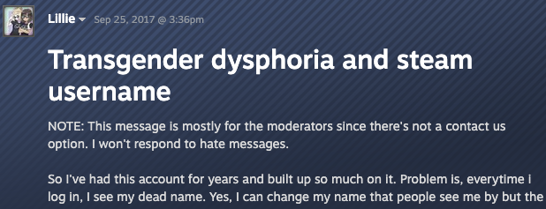
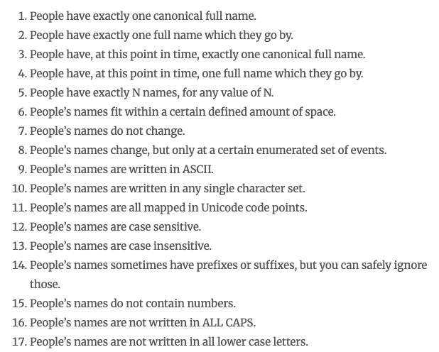
Even Database Schemas are Not Morally Neutral!
https://steamcommunity.com/discussions/forum/1/1496741765144289150/
https://www.kalzumeus.com/2010/06/17/falsehoods-programmers-believe-about-names/
Notes:
Software definitely encodes and enforces societal norms about how people are supposed to live, behave, and act in ways that aren’t easy to anticipate.
The Steam game store has had a known issue, for over a decade, that it’s not possible to change your username and keep your achievements and software purchases. This can be a big deal for folks who might include a part of their name in their Steam identifier, and later come to have negative associations with that name.
Trans people are one example, but there are lots of reasons people might be uncomfortable with a name they used for themselves in the past. There’s a whole amazing list of ways in which databases and software make assumptions about how names “ought to” work that turn out to be wrong. (“Ought to” is always a key that we’re dealing with ethical questions.)

Slide 18
Why is that not morally neutral?
So I've had this account for years and built up so much on it. Problem is, everytime i log in, I see my dead name. Yes, I can change my name that people see me by but the dead name is still in the topright corner of the window and i have to enter it every time i log in. This is so much dysphoria honestly and it bothers me a lot.

Slide 19
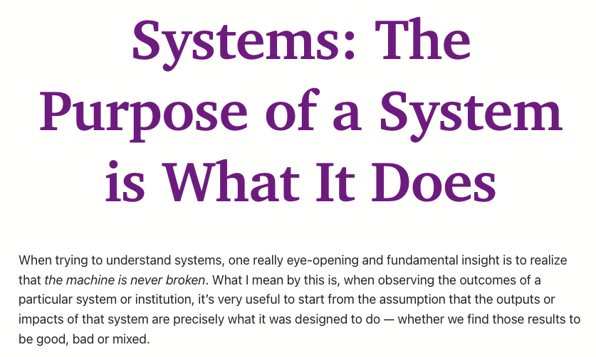
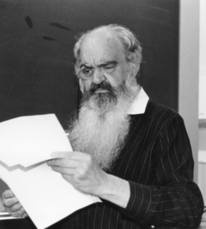
The Purpose of Code is What it Does
Stafford Beer, “management cybernetics”
https://en.wikipedia.org/wiki/Stafford_Beer
https://www.anildash.com/2024/05/28/systems-the-purpose-of-a-system/
Notes:
It’s not like Steam wanted to make life difficult for trans people and folks who change their names because of association with abusive parents or former spouses or whatever. if you think about how GameNite works, you can probably imagine a reasonable data model that they might use that would make this difficult. If the username itself is a key used everywhere, instead of a meaningless identifier, it could be very difficult to update the database to change a username without breaking everything.
That doesn’t mean that their software didn’t cause avoidable harm to people, though!
One tool for thinking about these kinds of problems is the awesomely named field of ”management cybernetic”, and Beer’s excellent slogan, “The Purpose of a System is What It Does.” POSIWID is described as a “heuristic,” it’s intentionally provocative.
Obviously it’s not precisely true — the purpose of the US medical system isn’t to prevent exactly 2/3 of people with cancer from dying — but it can be useful to think about the values encoded by a system in terms of what values that system seems to demonstrate.

Slide 20
Judge a system by its actual effects, not by its maker's intentions
We can be [most] effective when we fall in love with judging systems and institutions by the actual, real-world lived results and impacts that they have, especially the impact they have on the most vulnerable. Sometimes the stated values or purpose of a person or organization are useful in terms of judging what they have intended to do, but intent never matters nearly as much as impact, so we have to treat the actual outputs of that person or system as the ultimate truth when we assess them.
https://www.anildash.com/2024/05/28/systems-the-purpose-of-a-system/

Slide 21
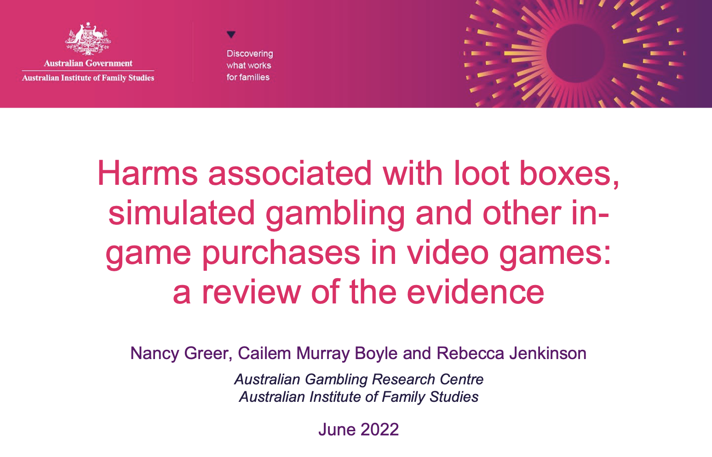
Judge a system by its actual effects, not by its maker's intentions
https://www.classification.gov.au/sites/default/files/documents/agrc_literature_review_final_20220906_accessible.pdf
Notes:
This means that you eventually need to study the effects in the wild , not just what a programmer can imagine. Here's an example (Flash back to s 17, "Things programmers believe…")
Discussion: If you imagine GameNite is website being actively used by millions of users… what do you think the values encoded in your projects might be? What might the harms be for deploying those software in the real world?

Slide 22
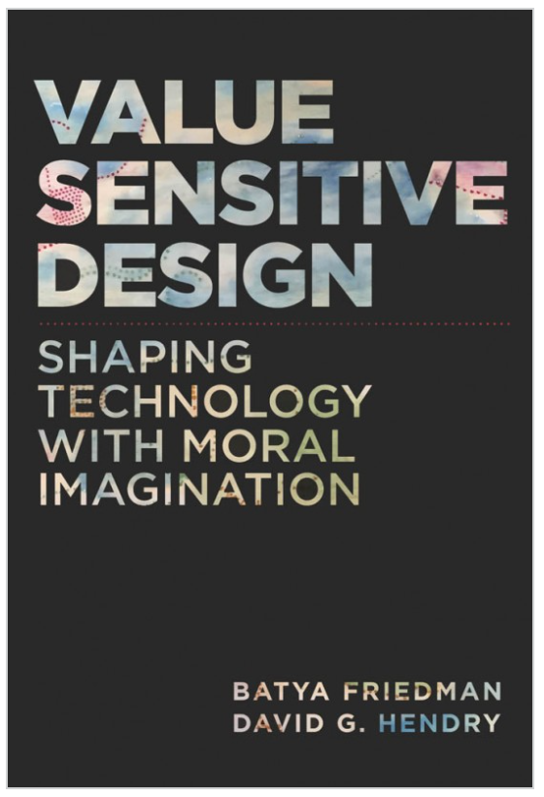
What values might our software promote or diminish?
Human rights - Inalienable, fundamental rights to which all people are entitled
Accessibility - Making all people successful users of the technology
Justice - Procedural justice (process is fair) + distributive justice (outcomes are fair)
Privacy - An individual’s agency in determining what information about them is shared
Human welfare - Physical, material and psychological well-being
“Value constraints,” can be framed as negative user stories:
“As a parent of a patient, I want my child’s medical records not to be disclosed to unauthorized persons.
Value Sensitive Design @ Khoury

Slide 23
Software engineers have professional obligations around ethical behavior

Slide 24
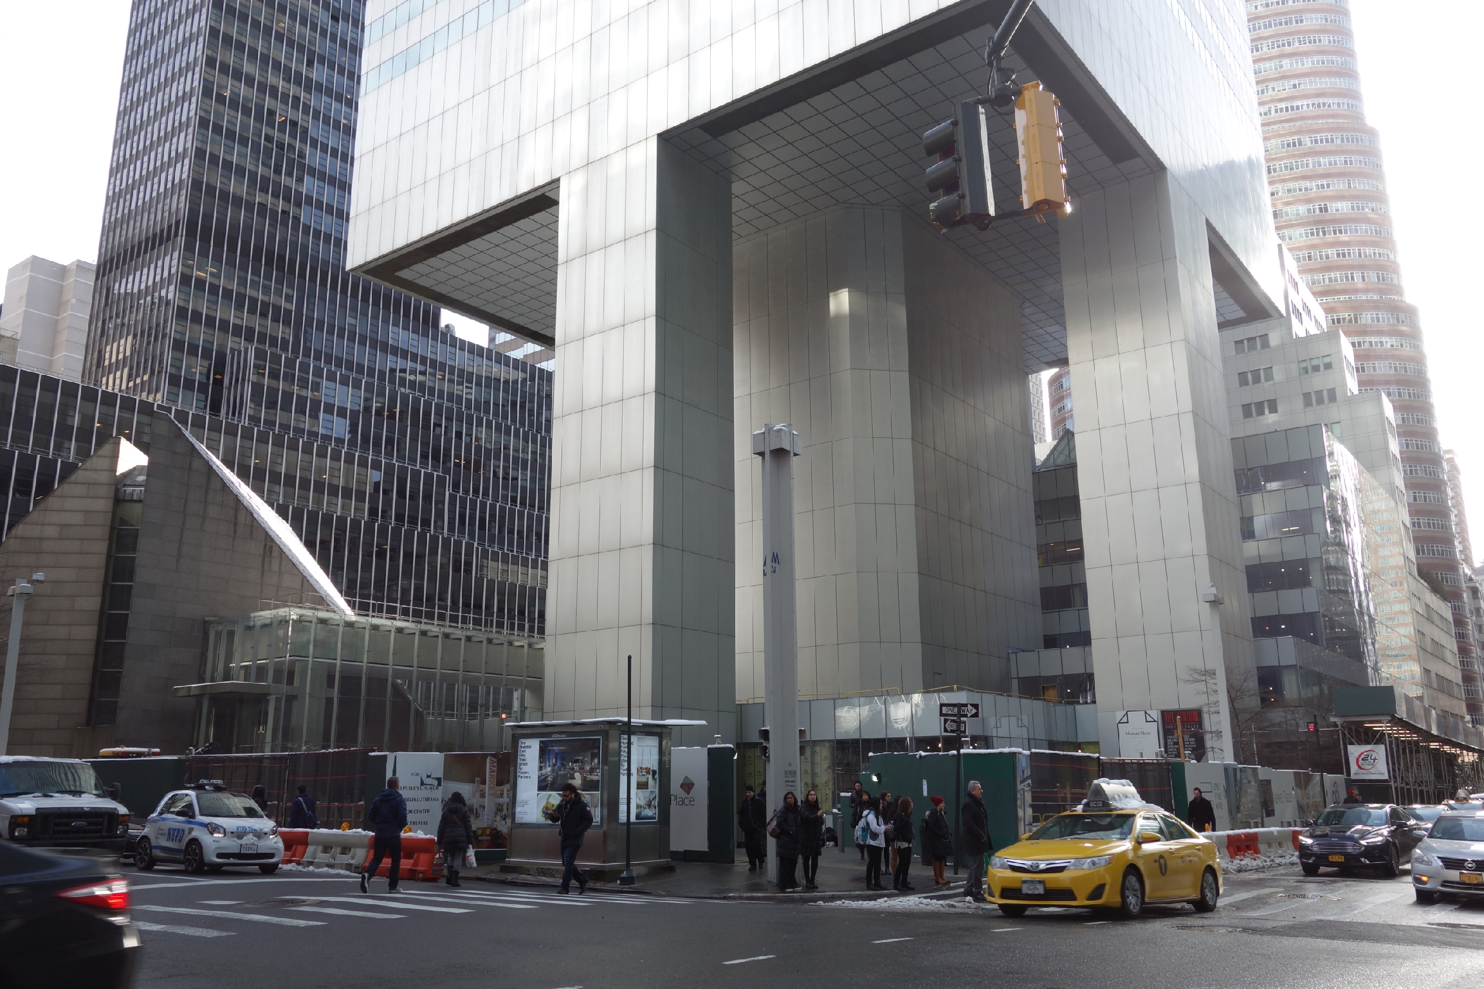
Following regulations alone is not enough
Citigroup Center
Design met building code, but did not account for all failure modes
Last-minute changes to construction increased odds of failure
Fixed before disaster could strike, but kept a secret for 20 years
https://en.wikipedia.org/wiki/Citicorp_Center_engineering_crisis
“Citigroup Center” by Tdorante10, Wikimedia commons, CC BY-SA 4.0
Notes:
Here’s a photo of the bottom of Citigroup Center, which was built 1974. It’s a very interesting building design: a 59 story tower cantilevered over a church - note this unique column architecture supporting the building. The engineer, LeMessurier, created a design that met building code (which in particular, required the design to be resilient to winds from N/S/E/W), but an analysis by an undergrad’s senior thesis found a diagonal hurricane-force wind would quite likely blow over the building. Usually face-on winds are the worst (for a building with columns on corners), but this building had columns in middle! Would have been OK if bottom joints were welded, but steel contractor wanted to bolt them to save millions of dollars, and was OKed. Fixed by the engineering firm, quite quickly, but also quietly. While being fixed added extra precautions to ensure safety and monitor weather, with evacuation plans. Kept secret for 20 years! This is a very interesting case study: note that the engineer did follow regulations, but still did not ensure safety in their design. Thankfully, the flaw was found by the student, and the engineering firm quickly took action to repair it, taking responsibility for the problem. One interesting discussion point here, however, is regarding how it was repaired - in secret!
Do you think that this design flaw should have been made immediately public?

Slide 25
ACM Software Engineering Code of Ethics
https://ethics.acm.org/code-of-ethics/software-engineering-code/
1. PUBLIC – Software engineers shall act consistently with the public interest.
2. CLIENT AND EMPLOYER – Software engineers shall act in a manner that is in the best interests of their client and employer consistent with the public interest.
3. PRODUCT – Software engineers shall ensure that their products and related modifications meet the highest professional standards possible.
4. JUDGMENT – Software engineers shall maintain integrity and independence in their professional judgment.
5. MANAGEMENT – Software engineering managers and leaders shall subscribe to and promote an ethical approach to the management of software development and maintenance.
6. PROFESSION – Software engineers shall advance the integrity and reputation of the profession consistent with the public interest.
7. COLLEAGUES – Software engineers shall be fair to and supportive of their colleagues.
8. SELF – Software engineers shall participate in lifelong learning regarding the practice of their profession and shall promote an ethical approach to the practice of the profession.

Slide 26
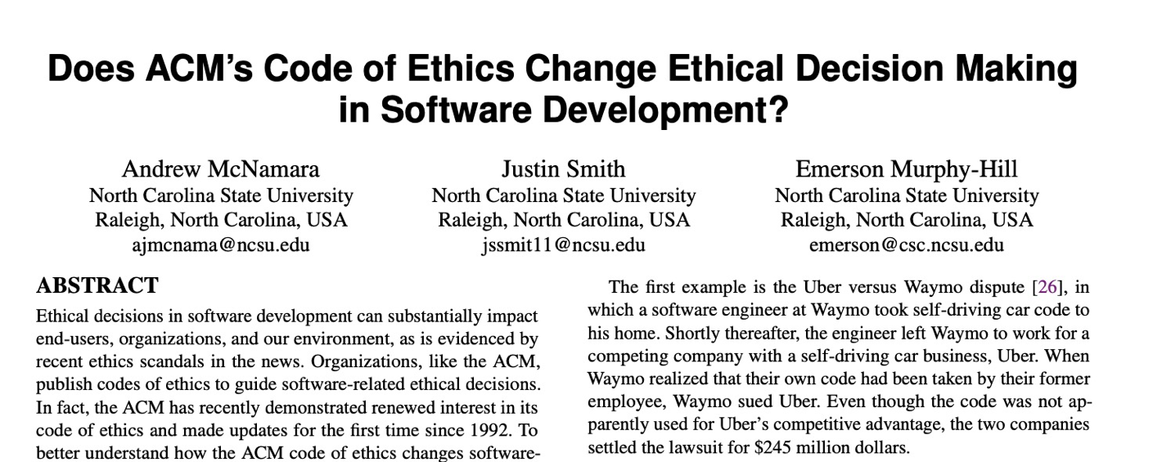
Does this code change developer behavior?
TLDR: No
Notes:
Studies have investigated whether simply exposing engineers to this code of ethics improves ethical decision making in software development
(Click)
(click),
concluding that this code alone does not improve ethical decision making.

Slide 27
Use SE-level mitigations for some of these risks
Form a diverse team
People from diverse backgrounds bring different experiences and different perspectives
Consider human values throughout the project
Be intentional (& flexible) about stakeholders
Rely on standards when possible
Monitor actual usage & misusage, user feedback
This is basically the philosophy of continuous delivery, but remember the McNamara fallacy (what gets measured is what gets done)

Slide 28
Where does this leave us?
So that we can sleep at night
Consider the different ways that our software may impact others
Consider the ways in which our software interacts with the political, social, and economic systems in which we and our users live
Follow best practices, and actively push to improve them
Encourage diversity in our development teams
Engage in honest conversations with our co-workers and supervisors to explore possible ethical issues and their implications.
Also… you just don’t always get to sleep at night.
Notes:
Final point is: sometimes we might make decisions as software engineers that cause harm to people! Taking responsibility for mistakes is a part of professional ethics, and a lot of harm can be done by refusing to admit that you’ve made a mistake — the point of thinking about ethics isn’t

Slide 29
Review
Programs are not morally neutral things
programs can have good and ill effects for people
programs represent and encode human values
Software Engineers have professional obligations around ethics

